Slide 1
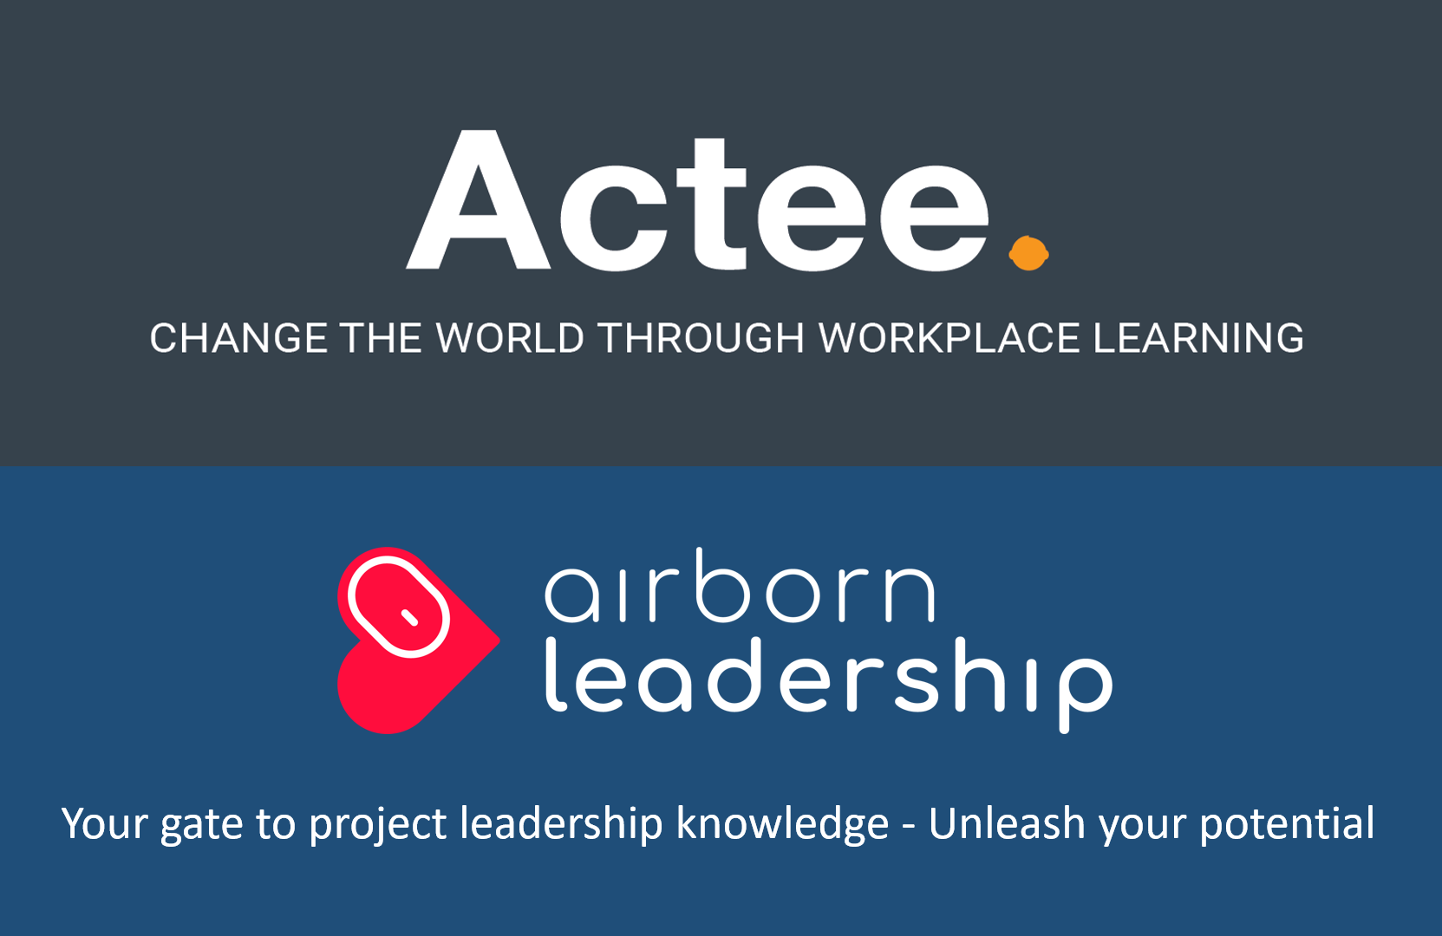
Go Green - a new PC project management game
focusing on impact and stakeholder management
We have joined forces:
Actee has been developing learning games in leadership, communication and change management for several years. The games are sold in 30 countries and have 250,000 users worldwide
airbornleadership is based on 30 years of project management experience. This knowledge exists, among other things in our e-learning and the books: Power in Projects, Programs and Portfolio, Project leadership - impact on time and Half Double.
See this short description of the game's professional content and structure
airbornleadership.com

Slide 2
The project leadership game, the case and the project
The game
In the game, you lead the project through the model on the next page. During this process, you choose different actions within the 6 management directions: management upwards, downwards, outwards, inwards, forwards and backwards. Based on your choice of leadership measures, stakeholders will change their perception of the project. See the model on page 3. The game contains a description of the various stakeholders in the project team, the steering committee and the reference group, as well as employees in the organization. The game focuses on achieving business impact and ensuring maximum stakeholder satisfaction.
The case
The case takes place in an international group within the production of medical equipment for hospitals. A large part of the customers is the public health service. In the EU and in many other markets, the public sector demands that suppliers work actively with the UN’s Sustainable Development Goals and fulfill the goals relevant to their products and production. Therefore, the project must be completed.
The Go Green project
The project aims to improve the measurement accuracy of one of the company's core products. It will also require changes in the production process as new technology can reduce energy consumption and waste. This entire transition places new demands on the production staff's skills and their work processes. The updated product also impacts service personnel and sales force. For customers to experience the benefits from the new features of the product, the sales force must undertake a new advisory task.
The game takes four hours and is completed in three rounds. During the game, you will receive information about the project's progress and stakeholder satisfaction. You also have the opportunity to view individual stakeholders’ comments on the project process.
airbornleadership.com

Slide 3
The game is conducted in the following project design
Project owner or steering committee
Project
manager
Reference group and stakeholders
Responsible
Workstream
Responsible
Workstream
Project team
Responsible
Workstream
Deliverables
New
competencies
New
behavior
Immediate
impact
Medium
term impact
Long-term
impact
Responsible
Workstream
Responsible
Workstream
Establishing the project and
creating the deliverables
Ensure behavioral impact
Ensure business impact
airbornleadership.com

Slide 4
In the game, you make decisions in the six leadership roles
Leadership
Leading the people
Management
Managing the assignment
Main tasks upwards:
Put the project on the agenda and secure the necessary framework. Business case, project effect and coherence with the strategy. Resources, your mandate and scope. Negotiation, decisions and approvals.
Main tasks outwards:
Expectation alignment with stakeholders, create acceptance and ambassadors through involvement. Receive knowledge of needs and concerns. Develop relationships, use change management, communication, facilitation and dealing with political challenges.
Main tasks forwards:
Develop project strategy and project design. Develop detailed objectives with SMART impact objectives. Organize the project and establish a management structure with clear roles.
Ensure overall and detailed planning, estimation and budgeting. Undertake risk management and change management.
Leading upwards
Leading
inwards
Leading
outwards
Leading
backwards
Leading
forwards
Main tasks inwards:
Developing your leadership style in the long term and adjusting your short-term leadership style.
Seek feedback, be reflective and proactive. Be aware of habits, integrity, empathy, credibility and thinking wind/wind.
Develop and maintain own values and leadership code.
Main tasks downwards:
Establish, develop and lead the project team. Motivation, leadership style, feedback, conflict management, coaching and meeting management.
Protect the project team from disruptions.
Management of subcontractors.
Main tasks backwards:
Follow up on time, budget and quality. Ensure impact monitoring and profit realization. Conduct reviews, consultations, tests, evaluation and secure learning. Provide feedback and develop a positive feedback culture.
Leading
downwards
airbornleadership.com

Slide 5
The six leadership roles and the project design
Project owner or steering committee
Leading upwards
Leading
inwards
Project
manager
Leading
outwards
Reference group and stakeholders
Leading
downwards
Responsible
Workstream
Leading
backwards
Leading
forwards
Responsible
Workstream
Project team
Responsible
Workstream
Deliverables
New
competencies
New
behavior
Immediate
impact
Medium
term impact
Long-term
impact
Responsible
Workstream
Responsible
Workstream
Establishing the project and
creating the deliverables
Ensure behavioral impact
Ensure business impact
airbornleadership.com

Slide 6
Scale for stakeholders' perceptions of the project
Positive
Interested
Active
support
Scale
Active resistance
Not interested
Interested
Active support
Passiv
Passive
Active
Not interested
Active
resistance
Negative
airbornleadership.com

Slide 7
Your leadership decisions impact the stakeholders
1
Positive
Change from passive to active:
Improve the opportunity to contribute. Actively involve and motivate action. Push to activate action. Make the project more important to the stakeholder. Use influence and pressure. Improve project perception as appropriate and important. Ask for help and support. Give stakeholder responsibility for sub-tasks.
Interested
1
Active
support
Passiv
Passive
Active
Change from negative to positive:
Change the assessment of the consequences, benefits and costs, as well as personal relevance. Improve the perception of fairness. Customize the impact for the person, department and organization. Improve the possibility for reducing disadvantages. Create understanding concerning the need for change and the vision. Improve the security of the journey towards the new future.
2
2
Not interested
Active
resistance
3
Change from active to passive:
Reduce their power base and influence. Expand your own power base and influence. Find substitutes that can contribute. Eliminate them through alliances with others. Charge them with other tasks. Increase the load in their involvement. Make the project less important to them.
Negative
3
airbornleadership.com

Slide 8
Create progress in the project and get all stakeholders on board
Active resistance
Not interested
Interested
Active support
Responsible
Workstream
Project
status
Responsible
Workstream
Project team
Responsible
Workstream
Deliverables
New
competencies
New
behavior
Immediate
impact
Medium
term impact
Long-term
impact
Responsible
Workstream
Responsible
Workstream
Establishing the project and
creating the deliverables
Ensure behavioral impact
Ensure business impact
airbornleadership.com

Slide 9
The project design, the game and the people
Petra
Project owner or steering committee
Adam
Production
Sale
You
Daniela
Felix
Project
manager
Projekt
leder
Reference group and stakeholders
R&D, technology
Responsible
Workstream
Carl
Bert
Responsible
Workstream
Edward
New
competencies
New
behavior
Immediate
impact
Project team
Responsible
Workstream
Deliverables
Iris
Medium
term impact
Long-term
impact
Mark
Ny adfærd
Responsible
Workstream
Hanna
Responsible
Workstream
Establishing the project and
creating the deliverables
Ensure behavioral impact
Ensure business impact
airbornleadership.com

Slide 10
The process and the facilitation of the game
Introduction and review of theory
The game takes place in three rounds and lasts 4 hours.
In each round, participants must consider 20 possible leadership actions. From these measures, the participants choose the most important 7 to 10 actions.
First, each participant chooses the action he or she prefers. The group then agrees on what action the group takes in the game. The group then reflects on the result before choosing the next action. After each round of play, plenary reflection is made.
Team
A
Team
B
Team
C
Result
Reflection
Next choice
2
4
7
8
7
Reflection on game round 1 in plenary
Team
A
Team
B
Team
C
Reflection on game round 2 in plenary
Team
A
Team
B
Team
C
Reflection on game round 3 in plenary
John Ryding Olsson – airbornleadership.com

Slide 11
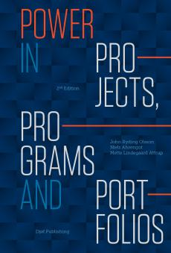
The game is based on the following project management books:
For Danish readers For international readers
airbornleadership.com

Slide 12
Get started playing
If you want to try the game in your organization then contact:
Inside Denmark:
John Ryding Olsson
Email: jro@airbornleadership.com
Phone: +45 311 811 66
www.airbornleadership.com
Outside of Denmark (International)
www.actee.com
Phone: +45 7070 7505
Email: info@actee.com
airbornleadership.com

Slide 13
Your gate to project leadership knowledge - Unleash your potential

